Slide 1

WEEK 3:
VERILOG, QUARTUS ıı & Altera board
Digital Design Lab. Section (EEE.2003.1)

Slide 2
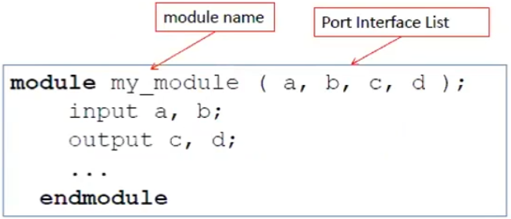
VERILOG HDL: Modules
Verilog is a hadware description language (HDL)
  Allows the designer to simulate and verify the design in every level
  Design consist of a hierarchy of modules

Slide 3
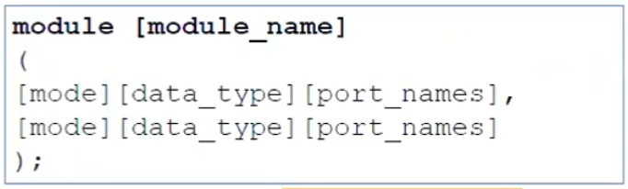
VERILOG HDL: Port Declaration
Verilog is a hadware description language (HDL)
  Allows the designer to simulate and verify the design in every level
  Design consist of a hierarchy of modules
The [mode] term can be input, output or inout!

Slide 4
VERILOG HDL: Basics I
4-Valued System:
  0: for «logic 0» or a false condition
  1: for «logic 1» or a true condition
  z: for the high-impedance state
  x: for an unknown state
Data Type Groups:
  Net: «Wire»
    wire p0, p1; // two 1-bit signal
    wire [7:0] sata1, data2; //8-bit data
    wire [3:0] mem1 [31:0]; // 4-bit data for each of 32 wires
  Variable: «Register»
    Reg [7:0] mem [31:0]; // 8-bit data for each of 32 memory

Slide 5
VERILOG HDL: Basics II
Number Representation
  General Form:
    [sign] [size]’[base][value]
    The [size] term specifies size of bits for a value (optional)
    The [base] term specifies base of the value
      b or B: Binary
      o or O: Octal
      h or H: Hexadecimal
      d or D: Decimal
    The [value] term specifies value of the number in a corresponding base
EXAMPLES
  8’b00011010 // 8-bit binary number: 26
  8’h1a // 8-bit hexadecimal: 26
  8’o032 // 8-bit octal number: 26

Slide 6
VERILOG HDL: Assignments
assign [signal_name]=[expression];
  wire o1; // net declaration
  assign o1 = i1 || i2; // continuous assignment
  wire o1 = i1 || i2; /* implicit continuous assignment: combines the net declaration and continuous assignment into one statement */

Slide 7
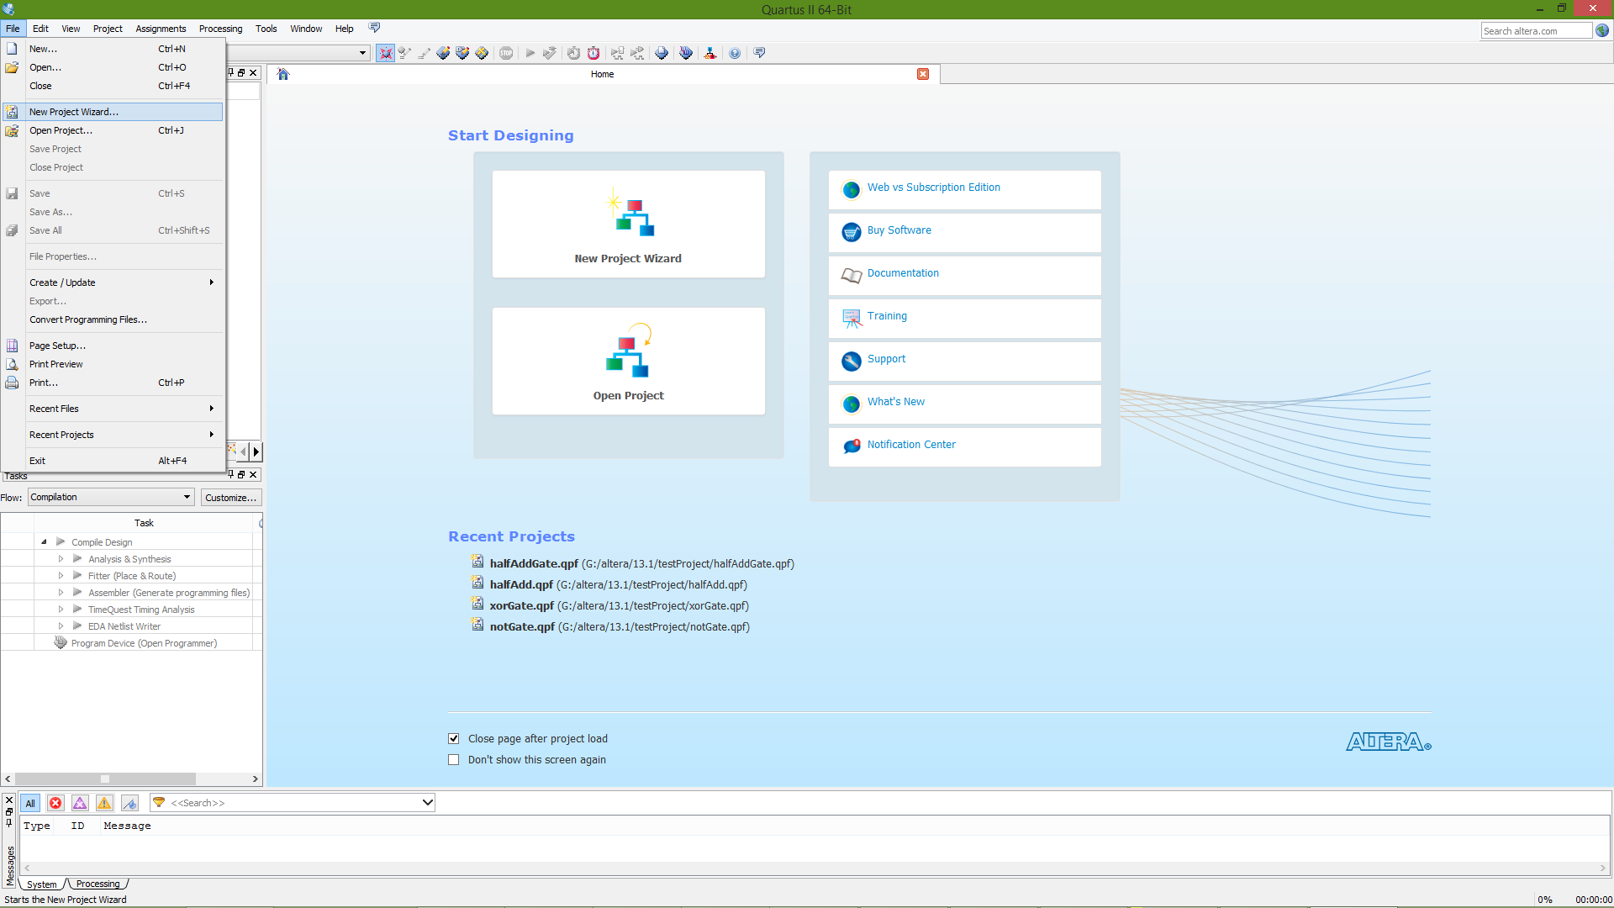
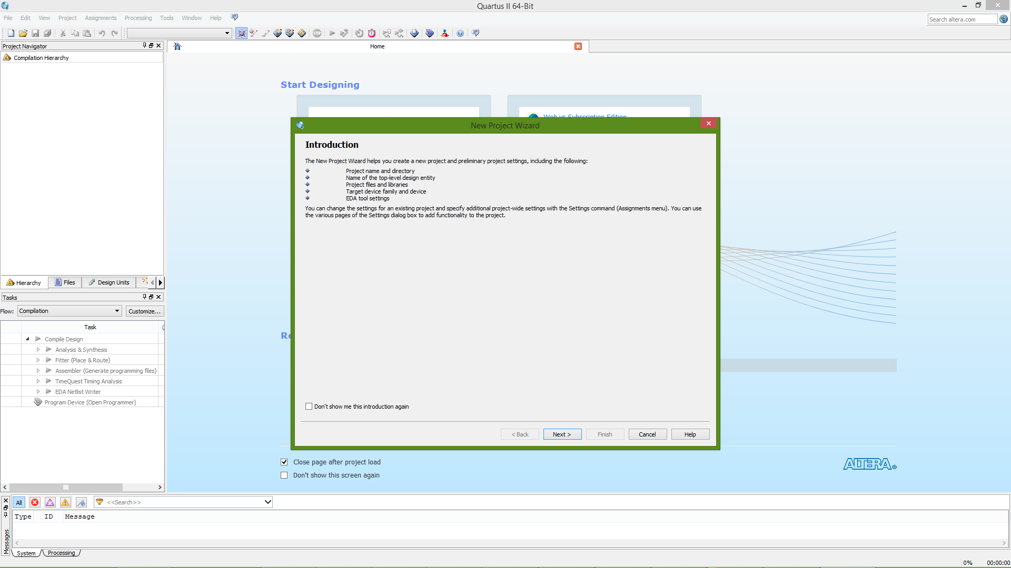
USING QUARTUS II SOFTWARE
1
To create a new Project:
File>>New Project Wizard
2

Slide 8
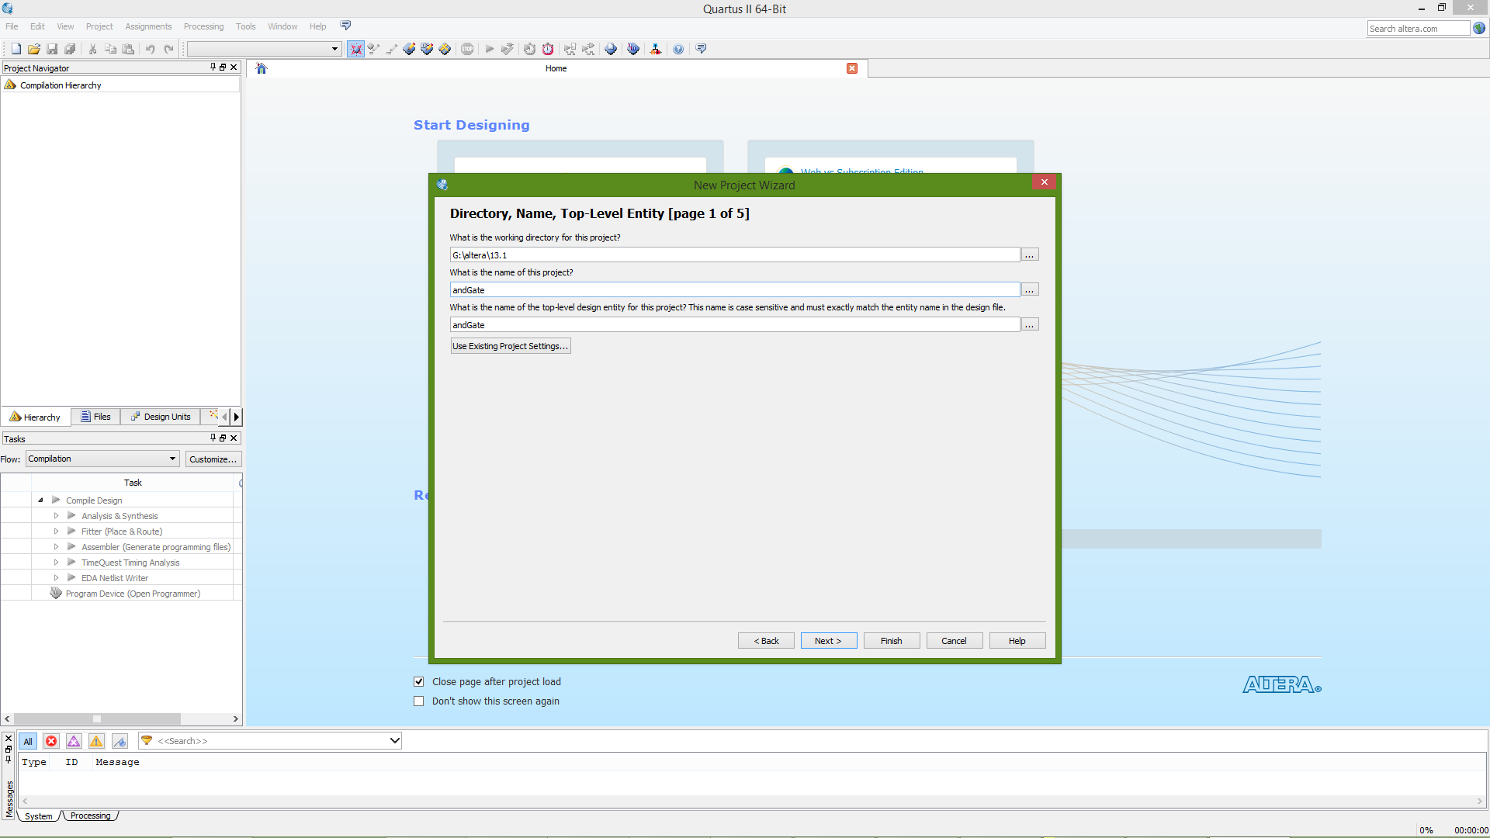
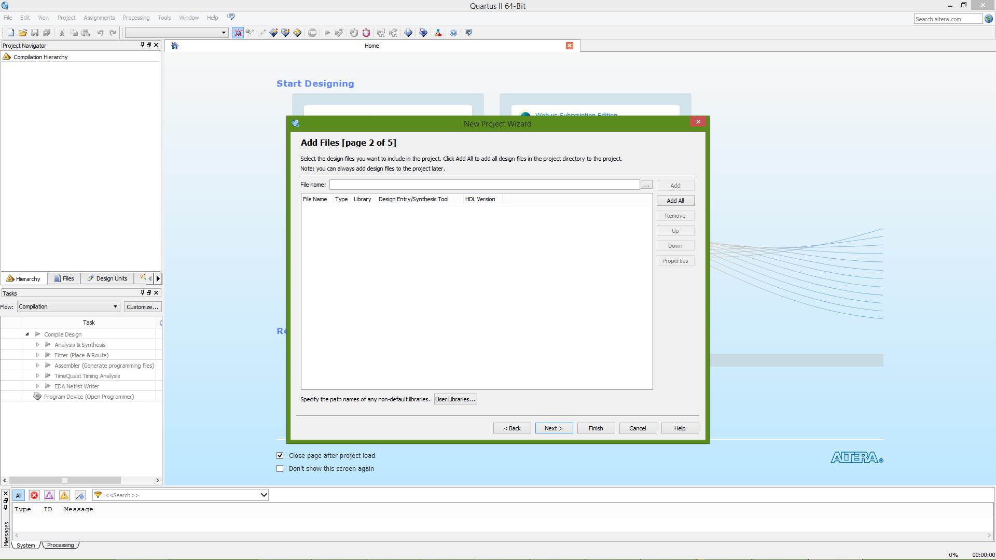
USING QUARTUS II SOFTWARE
Choose a folder to locate the Project and then give a name to the Project. Then click «Next»
A new window’ll appear, add your files to the Project if you have any! Then click «Next»
3
4

Slide 9
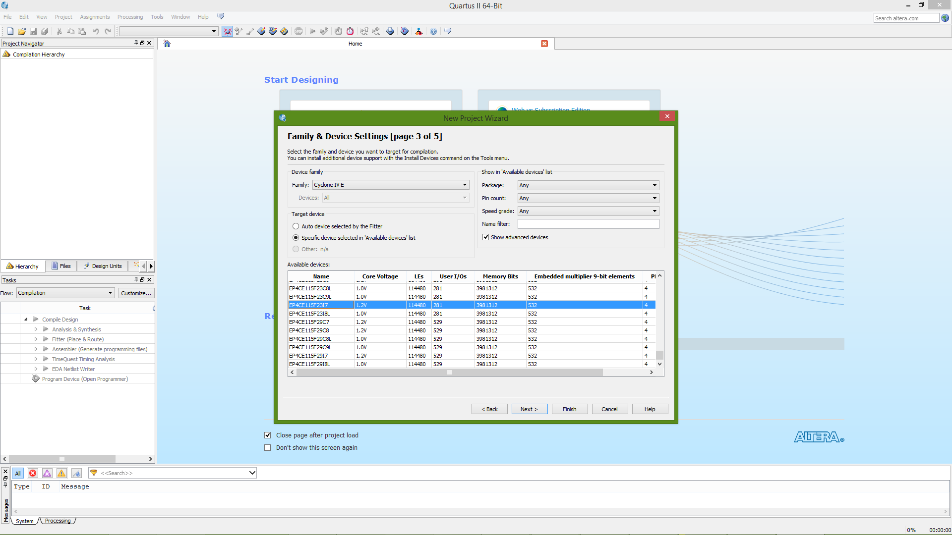
USING QUARTUS II SOFTWARE
Choose «Cyclone IV» as device family
Choose «EP4CE115XXXXXX» from the available devices:
5

Slide 10
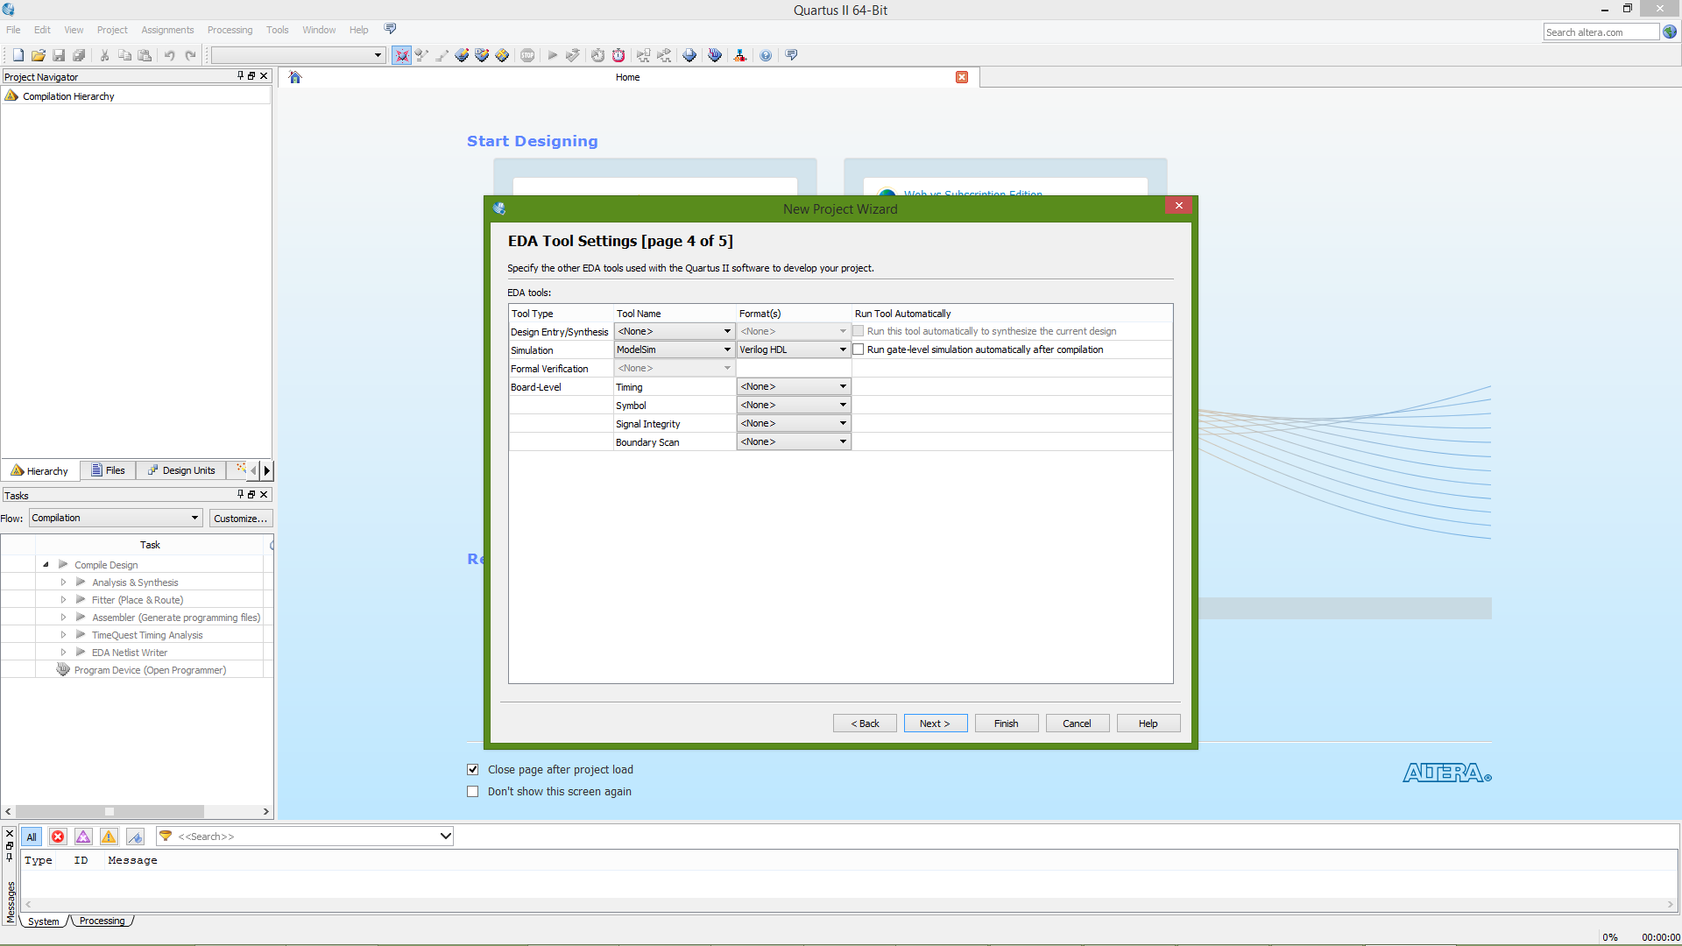
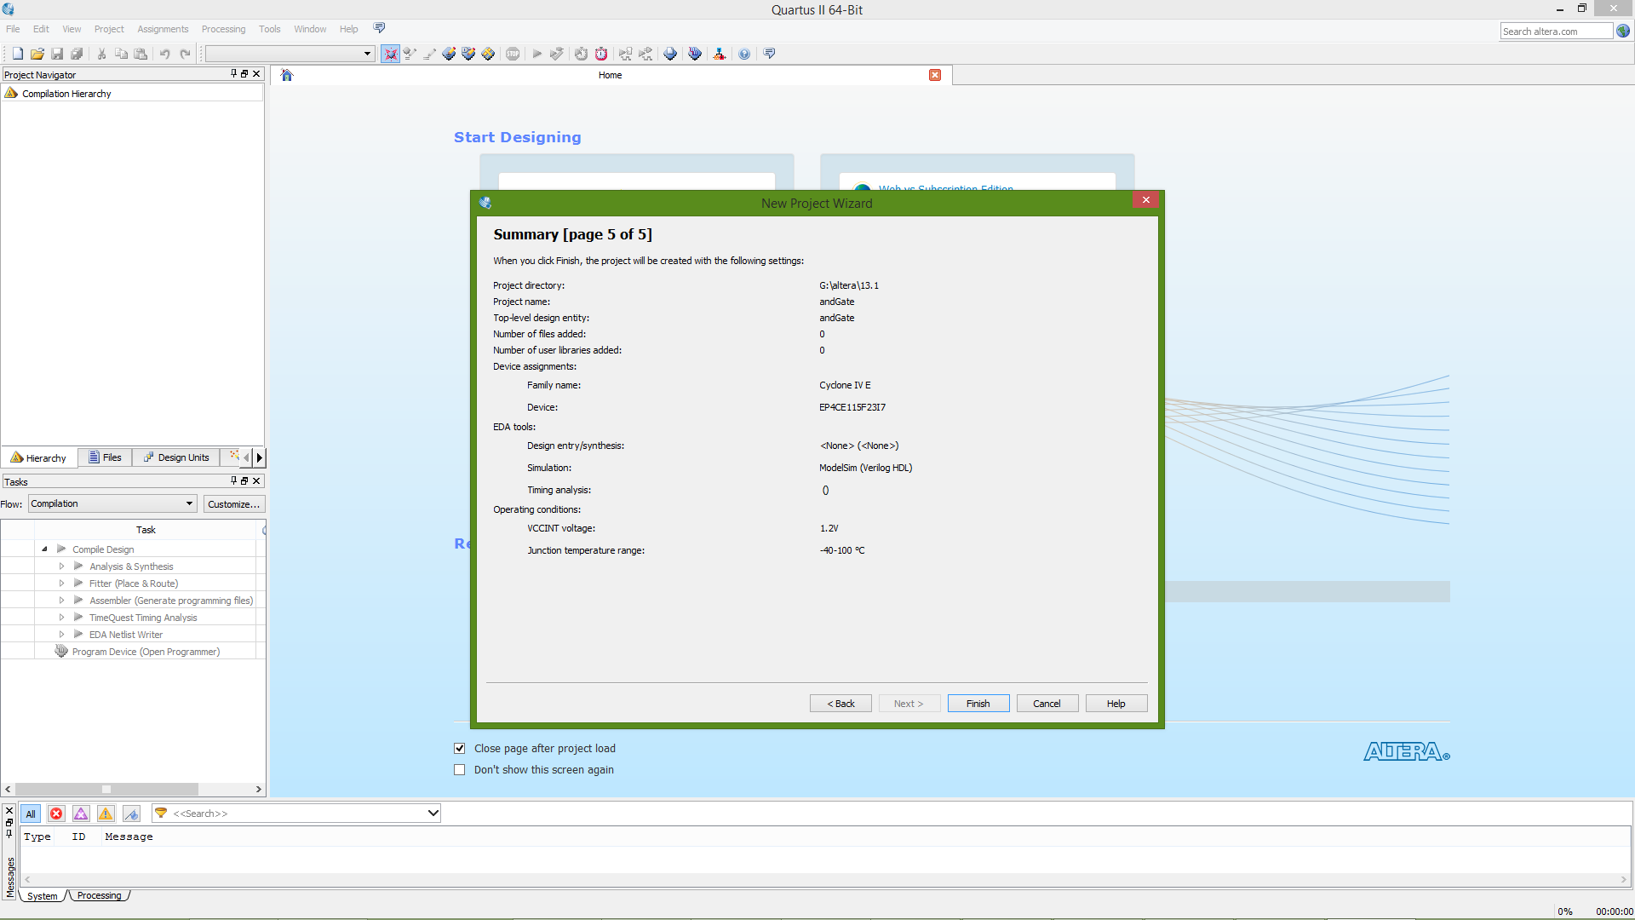
USING QUARTUS II SOFTWARE
6
7

Slide 11
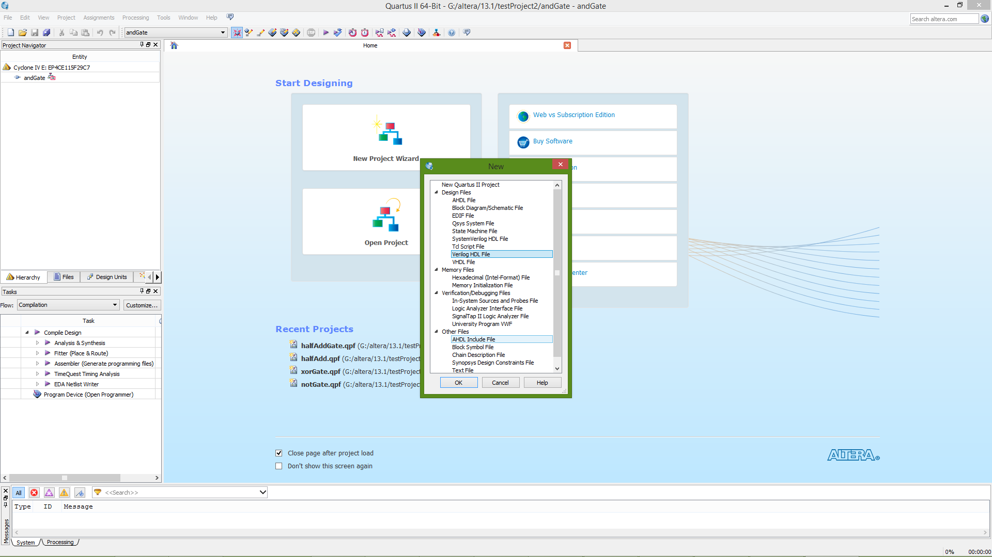
USING QUARTUS II SOFTWARE
Now our Project is created!
To add a new file to Project click «File>>New» and choose «Verilog HDL File» from the list and click «OK»
8

Slide 12
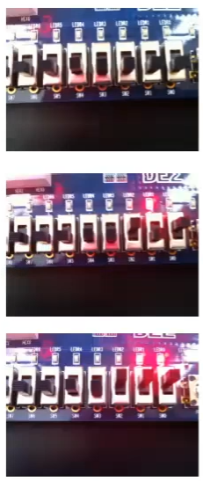
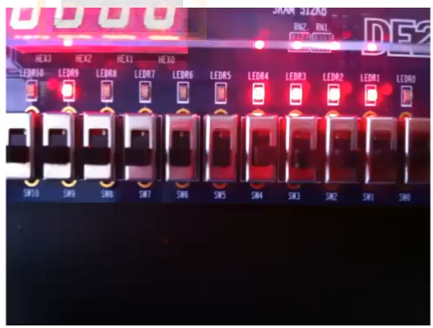
Altera DE2-115: Cyclone IV EP4CE115

Slide 13
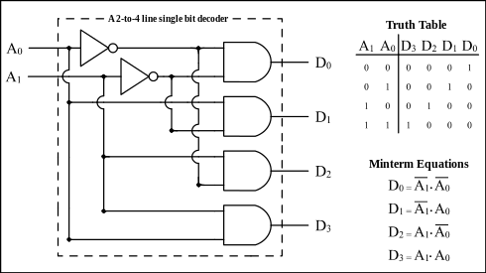
EXAMPLE: 2-to-4 line single bit decoder
2 inputs, 4 outputs
Not-Gate x2, And-Gate x4

